Slide 1
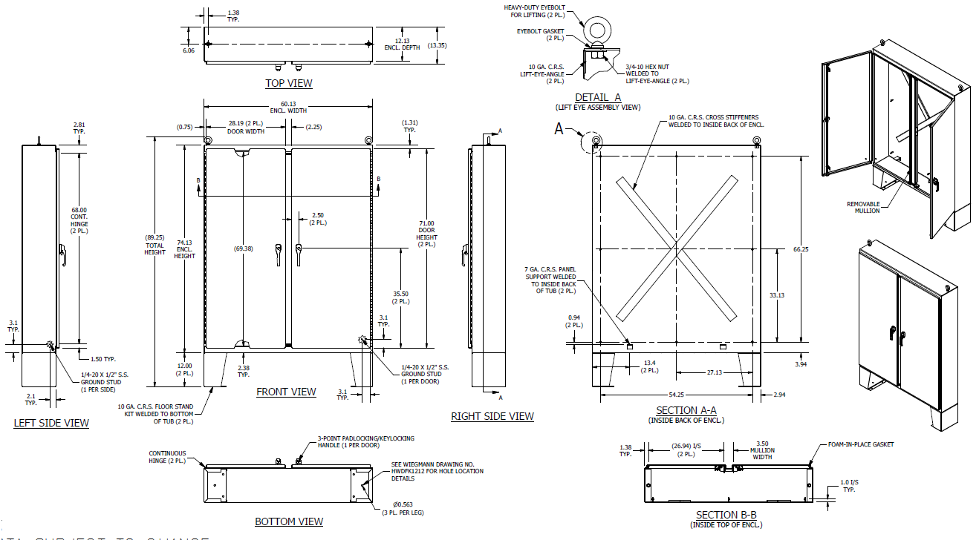

WIEGMANN
REP TRAINING
RMA PROCESS
Created by Matt Raetz, Randy Phillips, & Laurie Gavin
May 19th 2020

Slide 2

RMA Process for Stock Products
Standard stock product return:
  If the wrong part was received:
    Wiegmann customer service will provide a substitution form
    Complete substitution form and send back to the appropriate customer service representative (CSR)
  Standard return (no issues or concerns):
    All stock products that are not labeled as “Non-Returnable” can be returned by the reps by using the portal
      Contact Wiegmann customer service if you are not sure if the product is labeled as “Non-Returnable”
      Stock products are anything that can be found in Hubbell-Wiegmann’s catalog (off-the-shelf items)
    Information needed for standard stock return:
      Wiegmann Part #, Sales order Number, PO Number, Price Per Unit, Reason for Return, & Quantity being returned
  Stock return due to quality concern:
    Fill out RMA form (See slides 4-6 for more details)

Slide 3
RMA Process for Special or Custom Products
Specials CANNOT be returned
The exception to this is if there is a quality concern with the special
  RMA form to be completed by the rep and submitted to Wiegmann CSR
    See slide 4 for RMA example
  All necessary information must be provided to CSR for RMA to be processed
    See slides 5 & 6
  Wiegmann quality department will determine the appropriate course of action

Slide 4
RMA form Example
Input all cells highlighted in dark green
Contact CSR for blank form

Slide 5

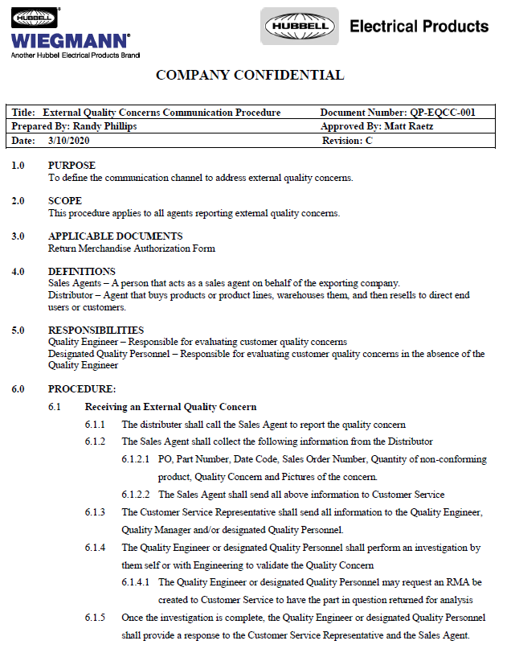
External Quality Concerns:
Standard Procedure Document Overview

Slide 6
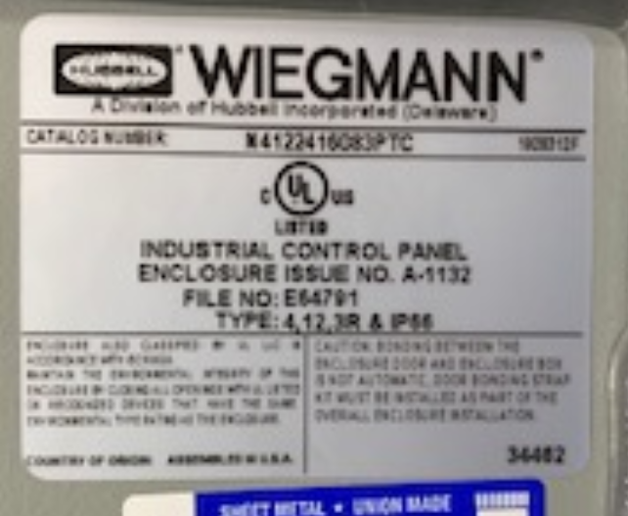
IMPORTANT INFORMATION TO PROVIDE FOR QUALITY CONCERNS
UL Label Example
Description of quality concern(s)
Hubbell-Wiegmann part number
Sales order Number
PO number
Invoice number
Date Code
Quantity of non-conforming product
Pictures showing quality concern(s)
Pictures of the UL label if applicable
(Usually located on inside of door)
Date Code
Part Number

Slide 7

Questions

